Slide 1
Hospital Database
Team 42

Slide 2
Team Members:
طوسون عبد الوهاب حسن
شيماء علي سيد
شيري متى إقلاديوس
حمد ايمن حسن
شيماء صابر قناوي
شيماء عبدالباسط محمد

Slide 3
The purpose of this project:
The project’s main idea is to make a database for hospital.
This database will store doctors',patients' ,nurses' and clinics' data using tables.
We link tables together so that it will be easy to access related data.
It will be easy to show, access and edit data by using queries , reports and forms.

Slide 4
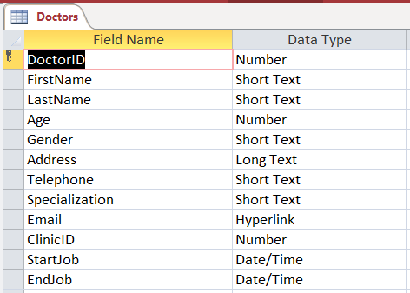
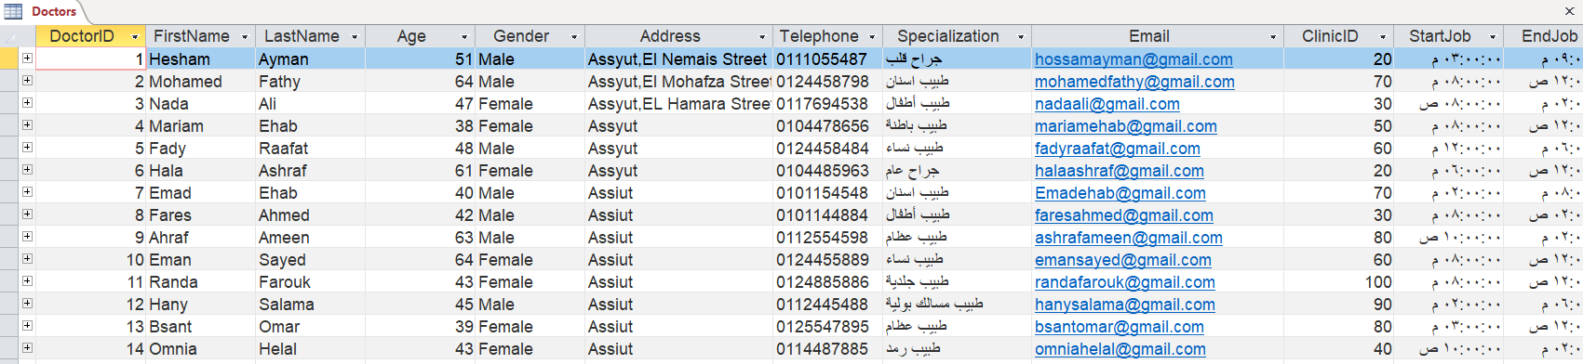
The project Explanation
Here is the tables :-
tblDoctors : We made a Doctor table with Doctor ID as a primary key and all information about the Doctor like doctor name,age,gender,address,telephone,specialization,email,clinicID,startJob,EndJob.

Slide 5
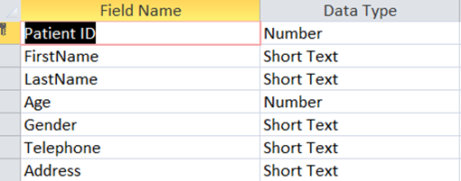
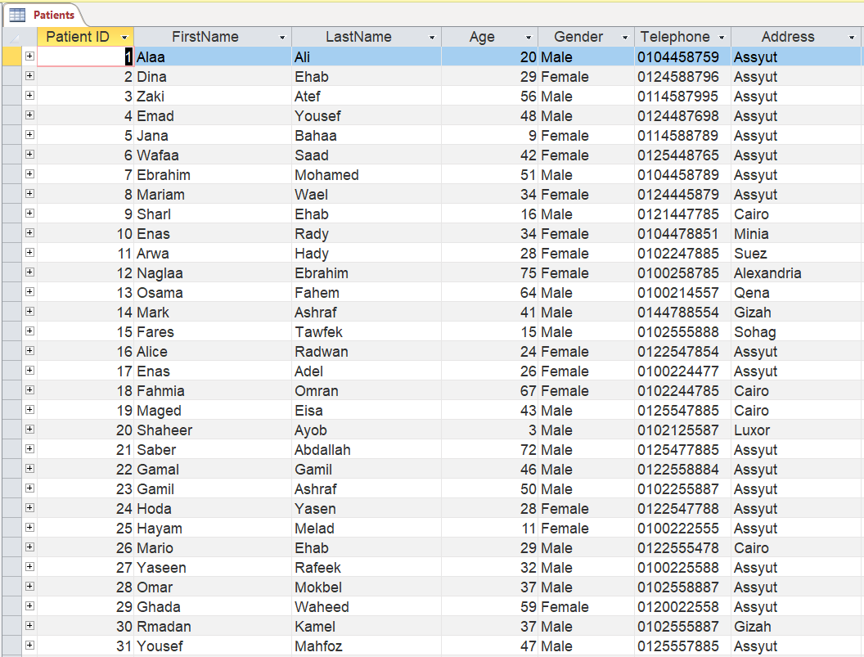
tblPatient:
We made a Patient table with Patient ID as a primary key and all information about the Patient like Patient name,age,gender,address and telephone .
Here we full the table with data

Slide 6
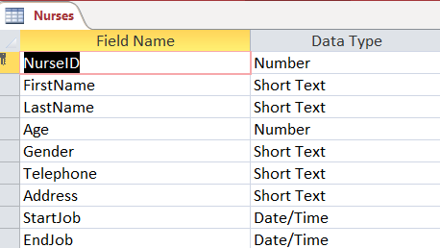
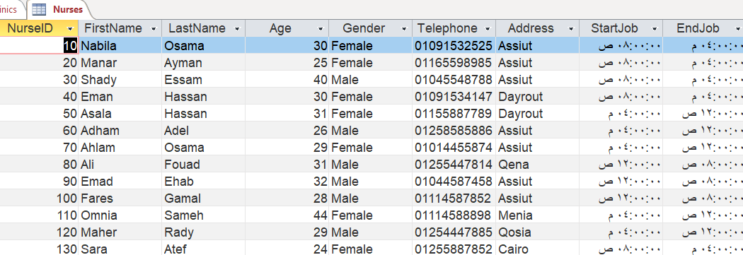
tblNurses
: We made a Nurses table with Nurses ID as a primary key and all information about the Nurses like Nurses name,age,gender, telephone ,address, ,startJob and EndJob.

Slide 7
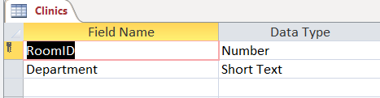
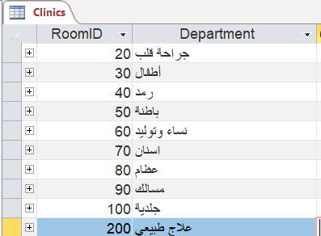
tblClinics
: We made a Clinics table with room id as a primary key and the clinic's department name.

Slide 8
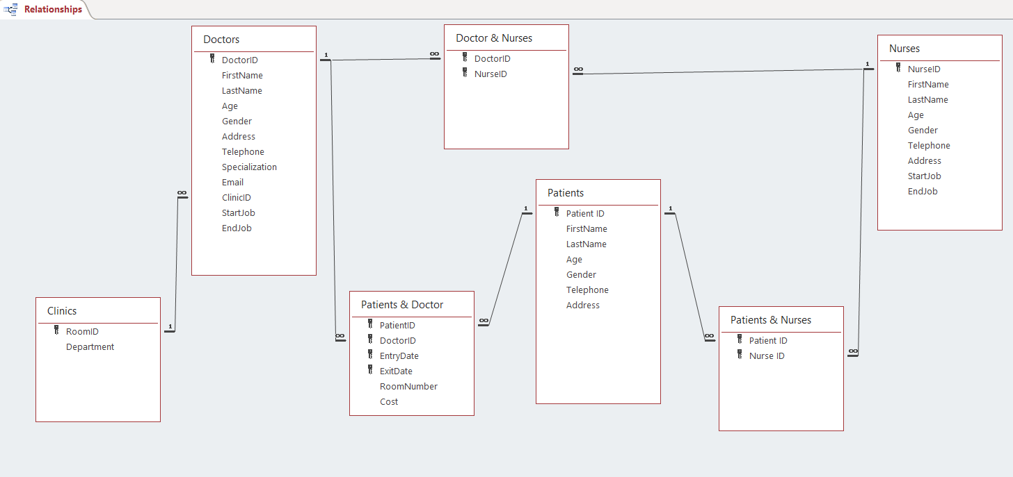
The relationships:-
From clinics to doctors we have one-to many relation.
Patients & nurses is many-to-many relation.
Doctors & nurses is many-to-many relation.
Patients &doctors is many-to-many relation

Slide 9
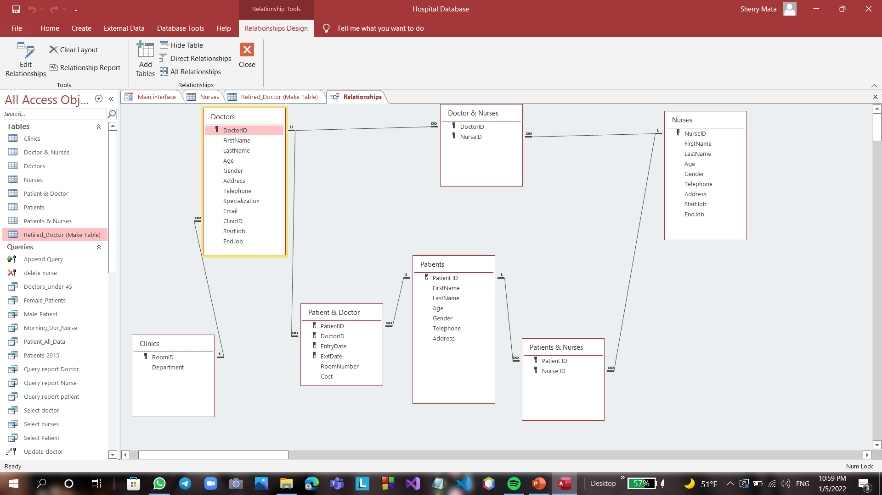

Clinics – Doctors (One to Many):
Each doctor can have one clinic but clinics may used by many doctors.
Doctor & Patient (Many To Many):
(Junction Table)
Doctor can examine many patients and patients can be examined by many doctors and can come many time to the same doctor at different times.
Doctor&Nurses (Many To Many):
(Junction Table)
Doctor can work with many nurses and so on the nurses.
Patient&Nurse (Many To Many):
(Junction Table)
Nurses can help many patients and patients can be helped with many nurses.

Slide 10
Queries:-

Slide 11
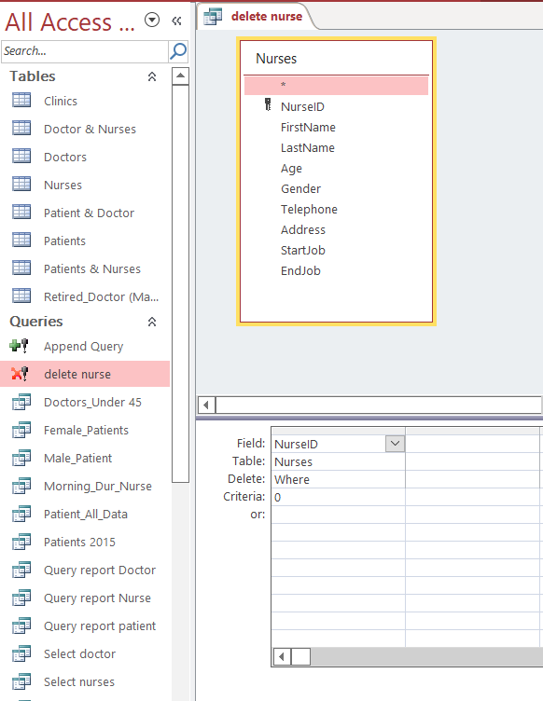
Delet query QryNurse
we find that it has been deleted for all the Nurses that have their id 0

Slide 12
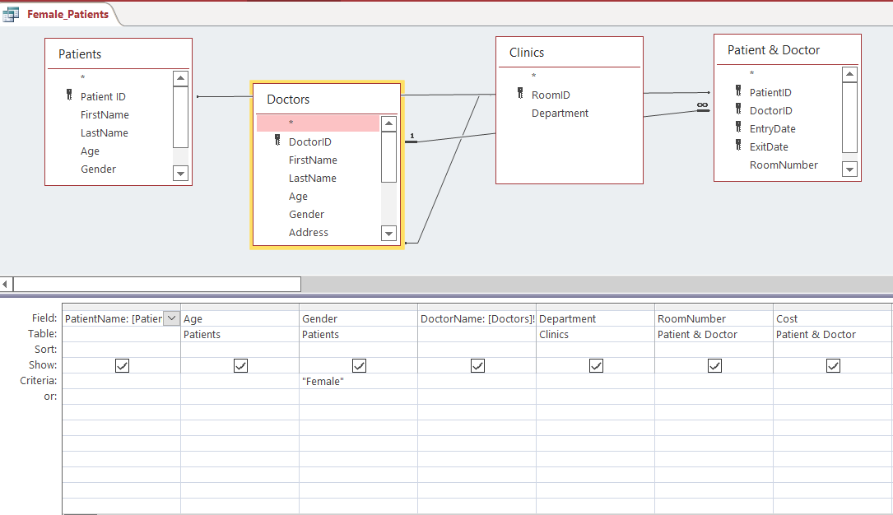
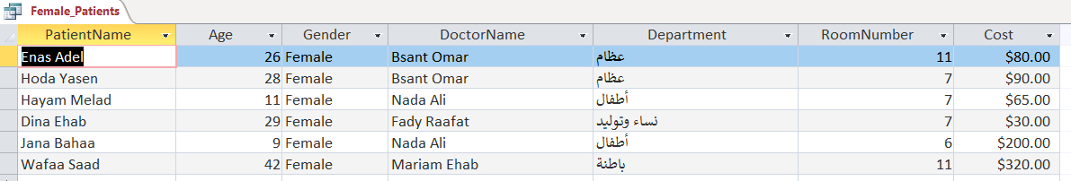
In QryFemale_Patient
We select patient gender

Slide 13
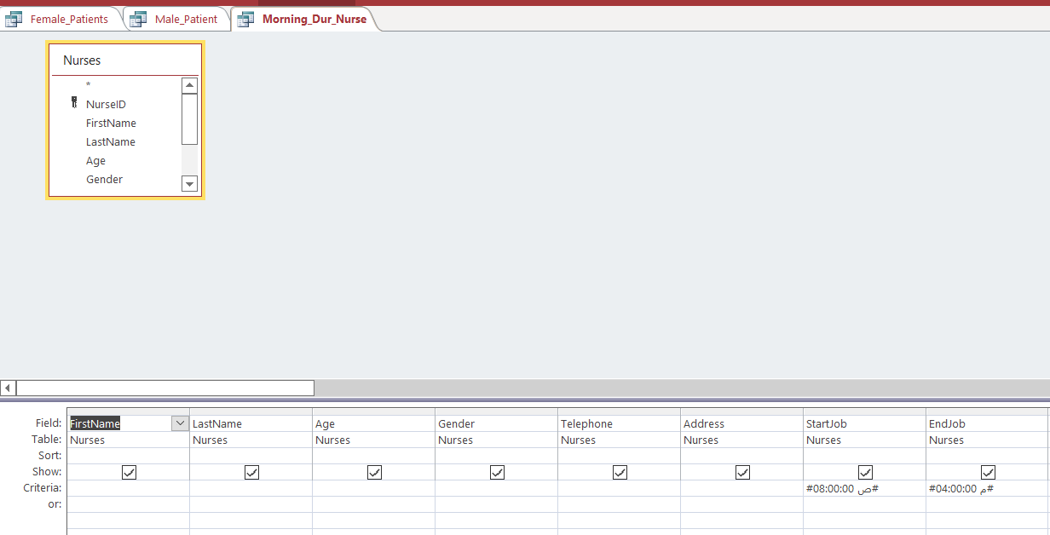
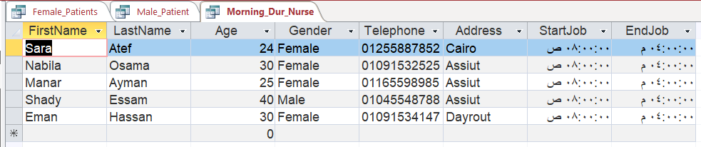
QryMorning_Dur_Nurse:
This query displays nurses' morning duration

Slide 14
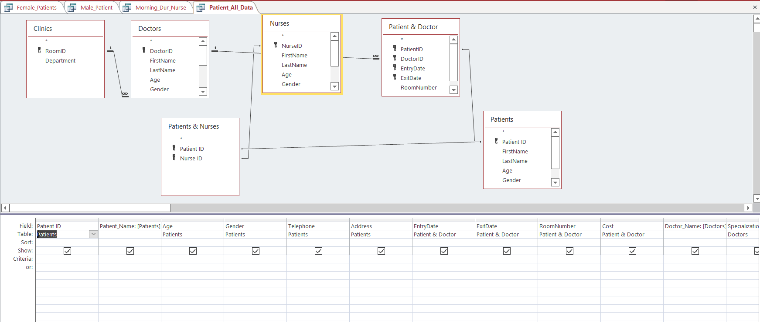
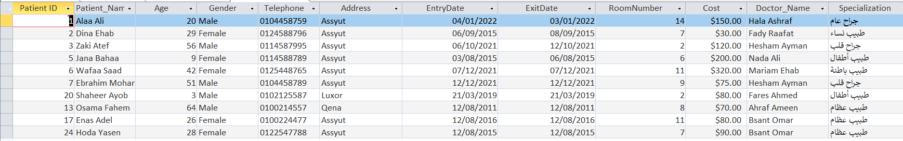
QryPatient_All_Data:
This query displays all data abut patient

Slide 15
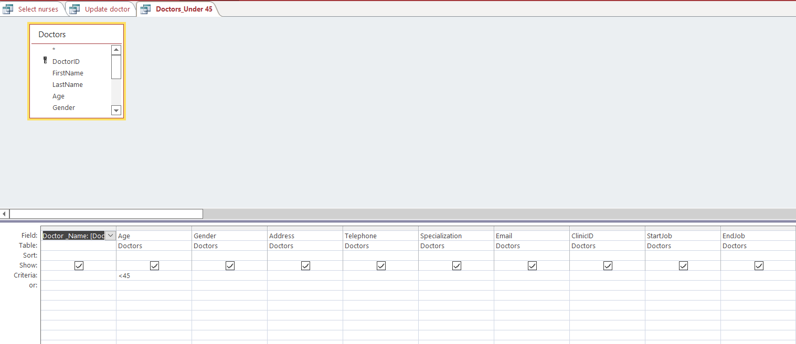
QryDoctors_Under45
This query displays doctors’ under45 data

Slide 16
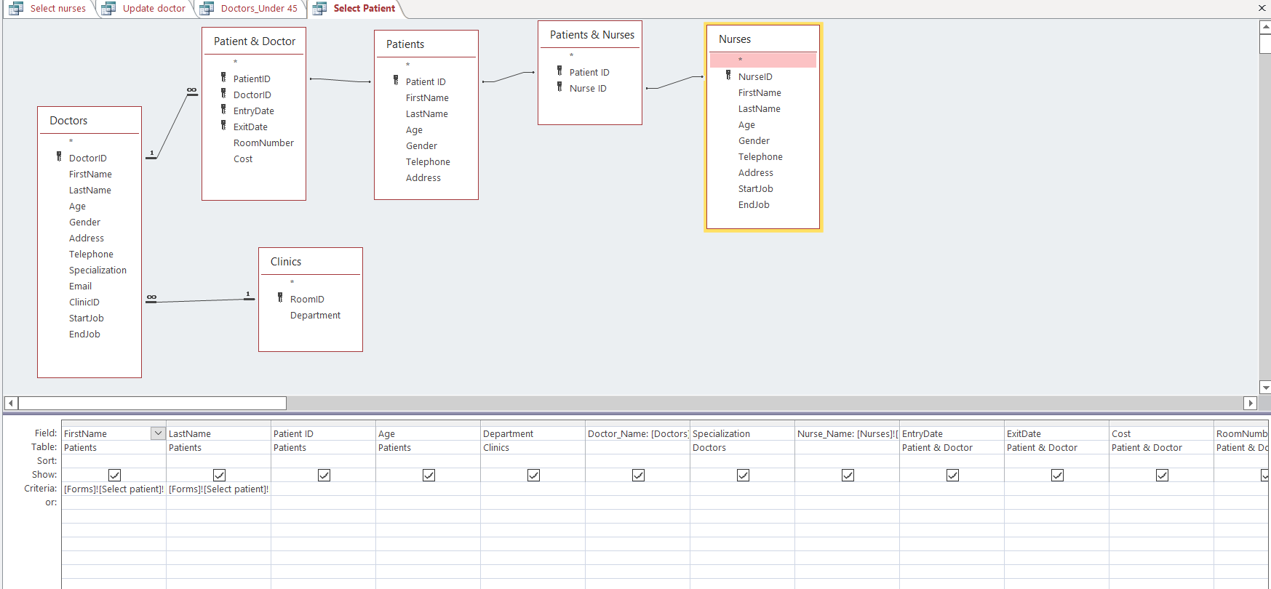
Select query
We have 3 select query for doctor , nurse and patient.
Here is a simple (select patient).

Slide 17
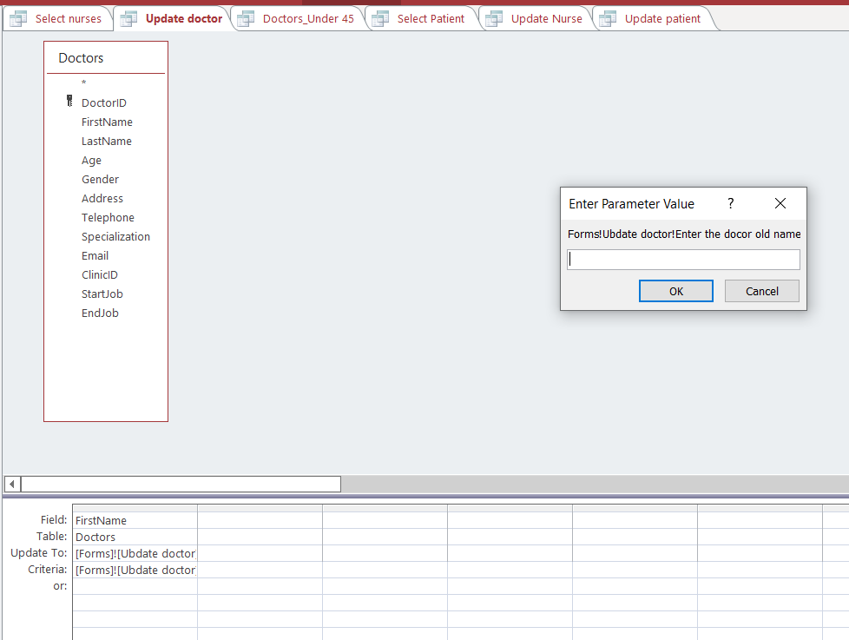
UpDate Query
We have 3 update queries for doctors , patient and nurses.
This is a (QryDoctors).

Slide 18
Forms

Slide 19
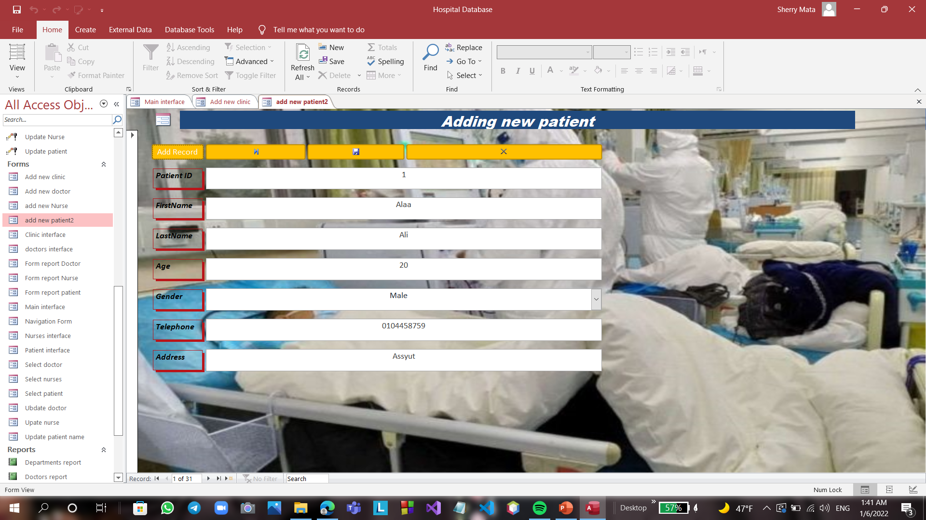
Patient Form:
User can use this form to add new patient ,save updates ,bring next record or bring last record.

Slide 20
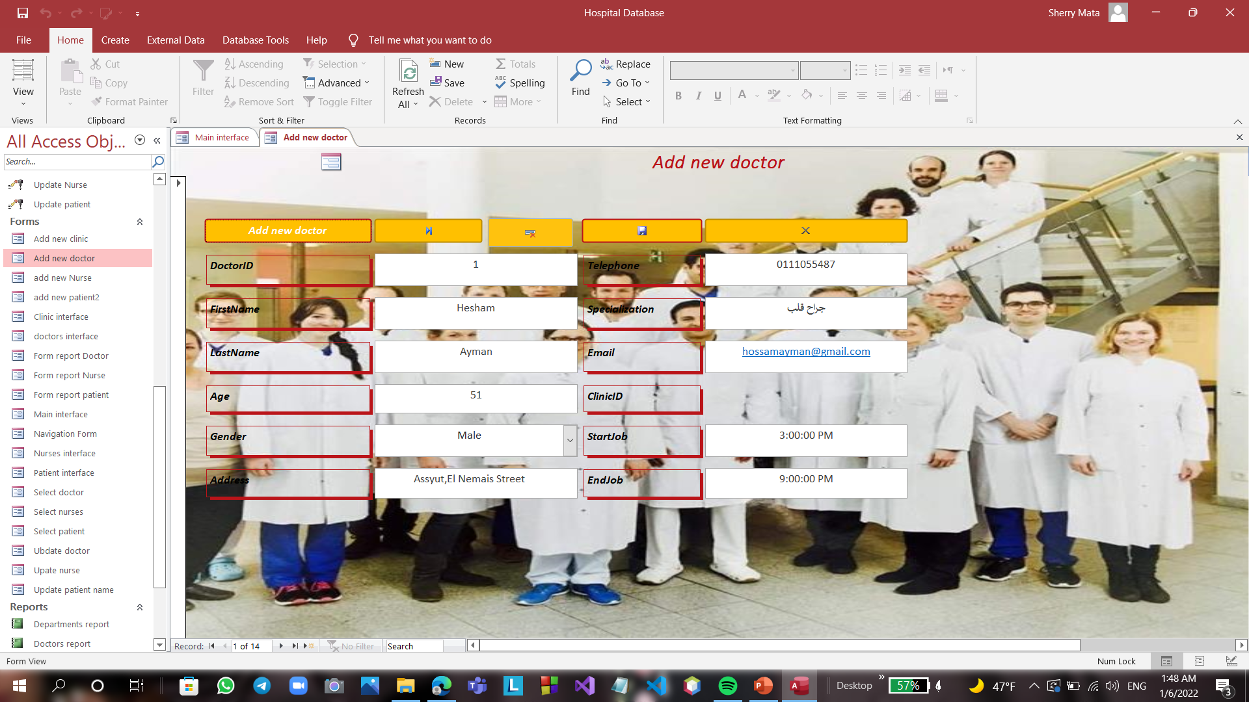
Doctors Form:
User can use this form to add new doctor ,save updates , delete record, bring next record or bring last record.

Slide 21
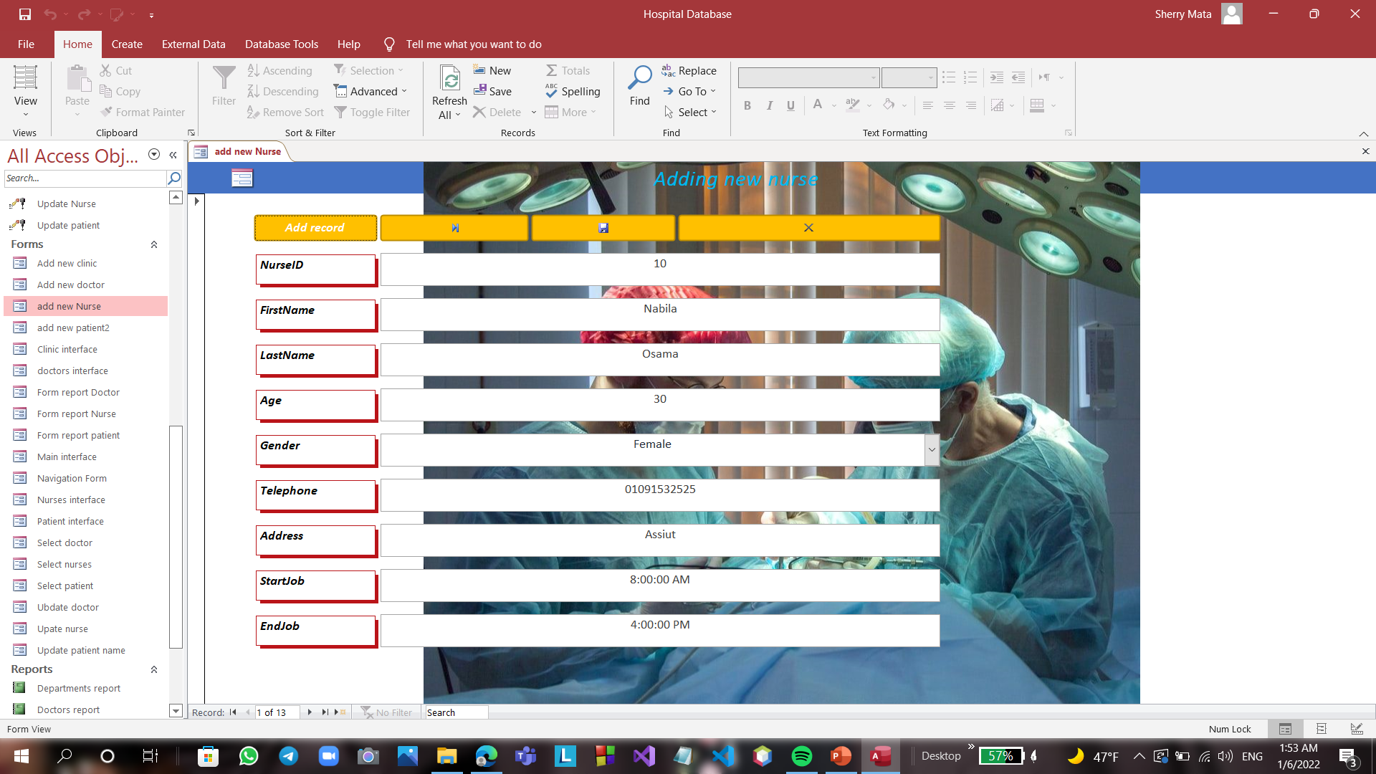
Nurses Form:
User can use this form to add new nurse ,save updates , delete record, bring next record or bring last record.

Slide 22
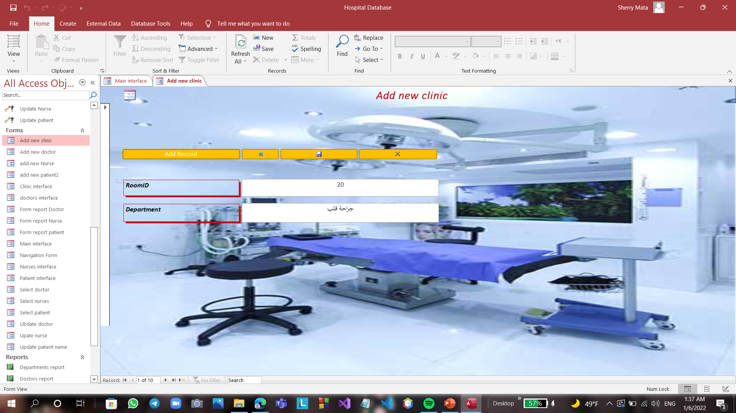
Clinics Form:
User can use this form to add new Clinic ,save updates , delete record, bring next record or bring last record.

Slide 23
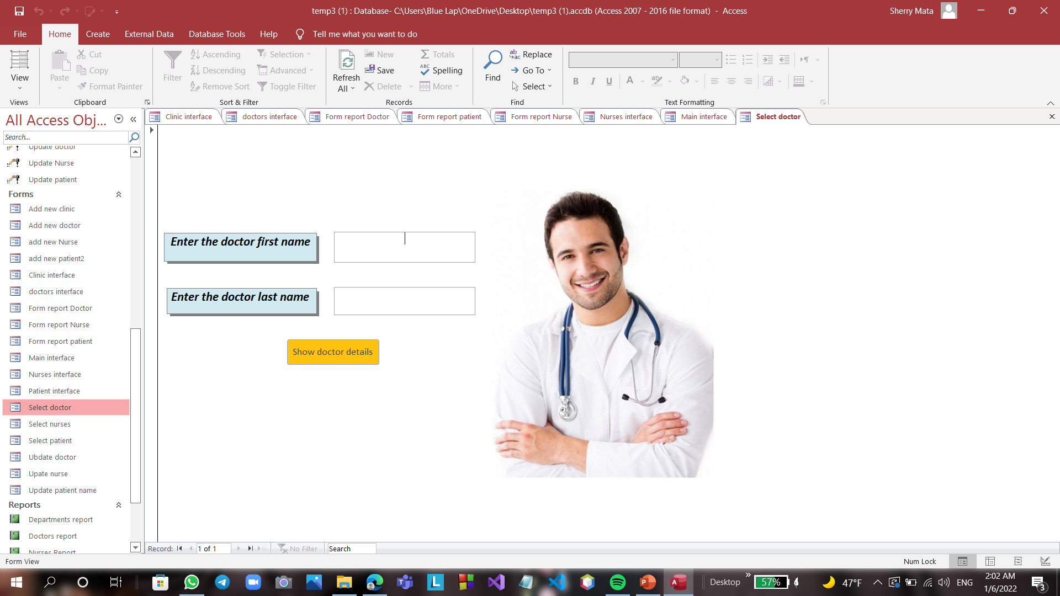
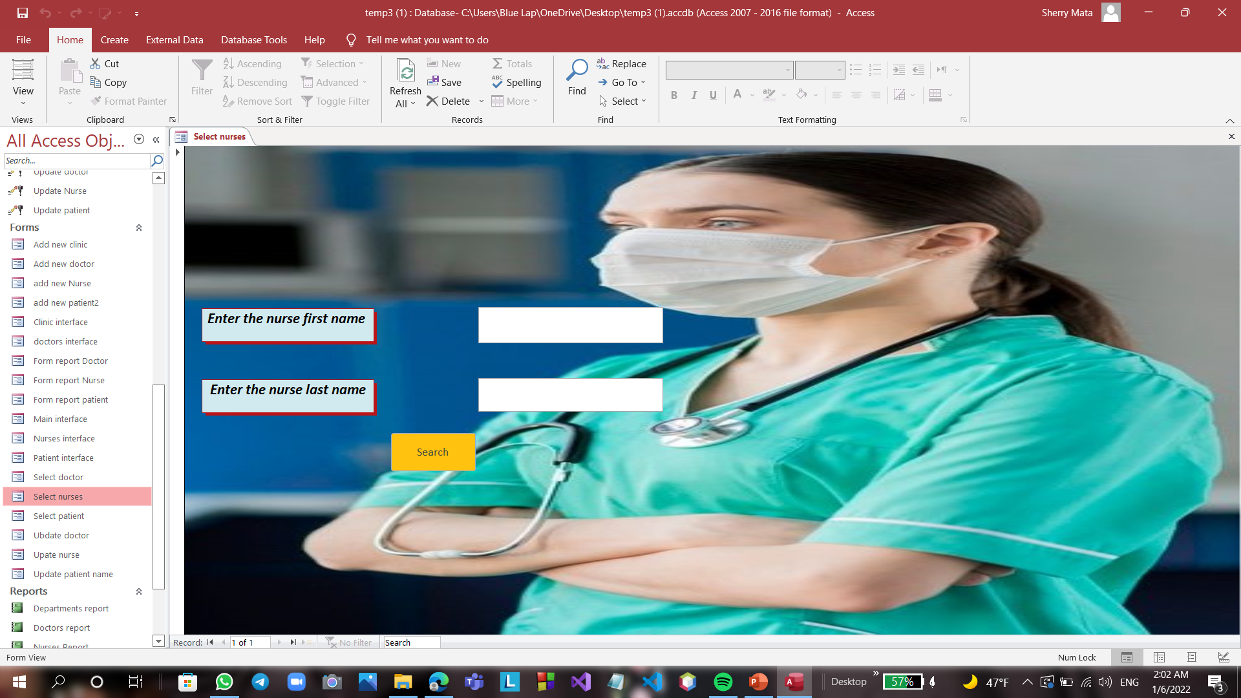
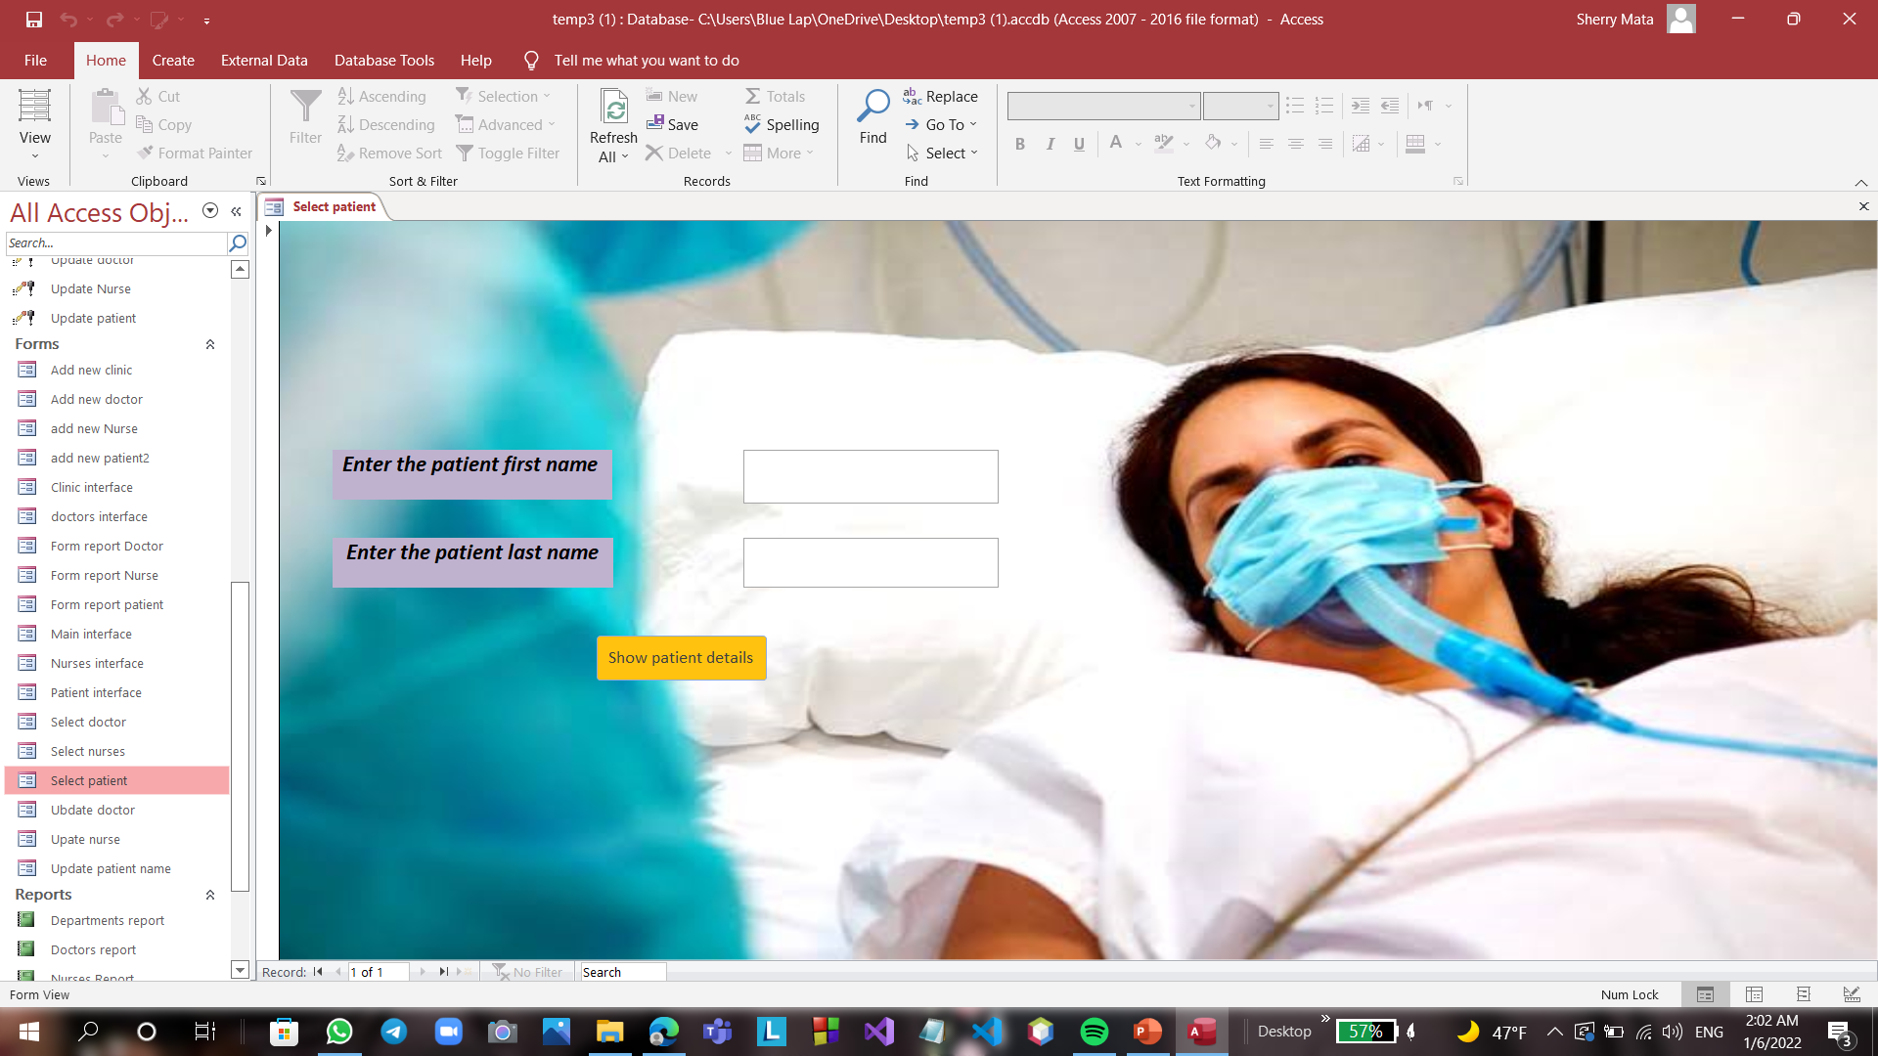
Select Forms:
We have 3 select forms ,these forms linked with select queries .
(Select Patient , Select Doctor , Select Nurse)
With these forms we can enter first and last name of doctor , patient and nurses and will show us the specific person that we’re looking for.

Slide 24
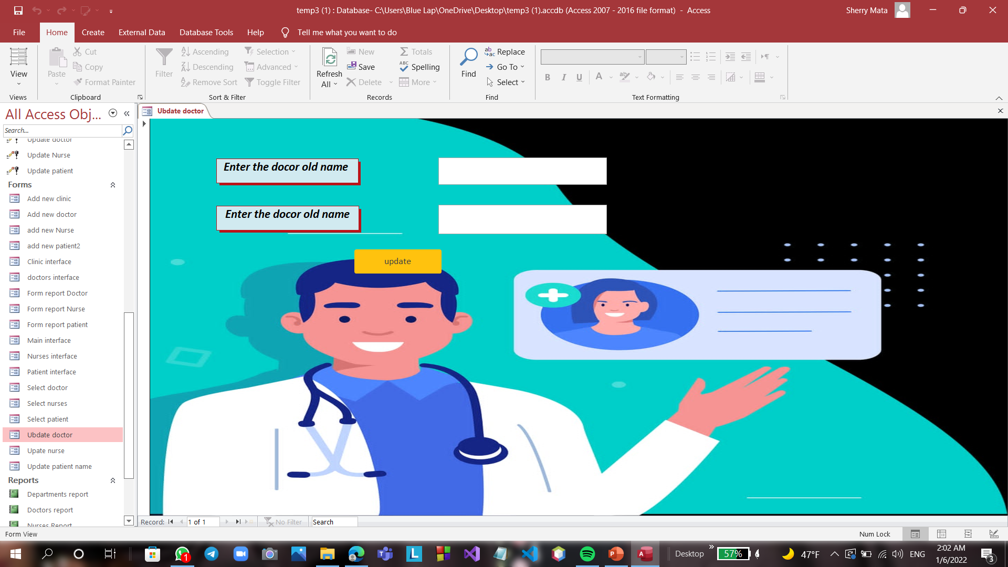
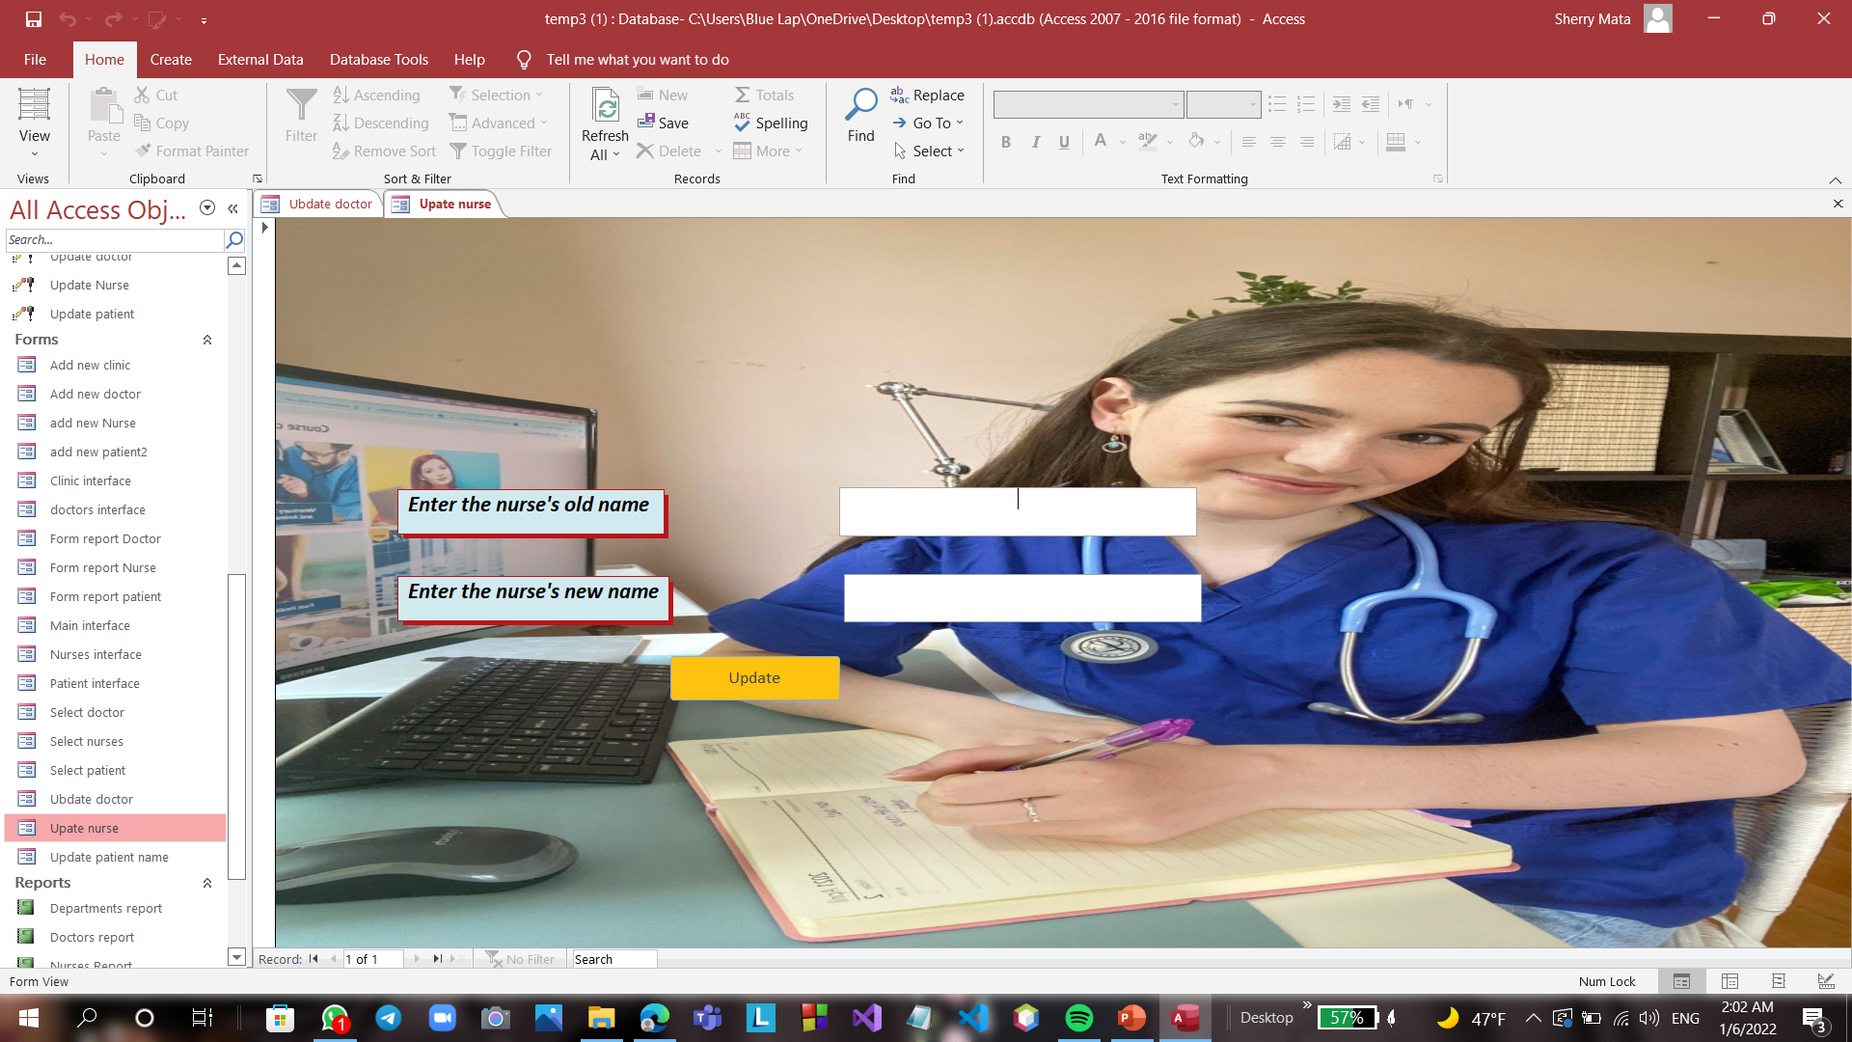
Update Forms:
We have 3 update forms ,these forms linked with select queries .
(Update Patient , Update Doctor , Update Nurse)
With these forms we can update first name, last name or both of doctor , patient and nurses and will show us the specific person that we make him update.

Slide 25
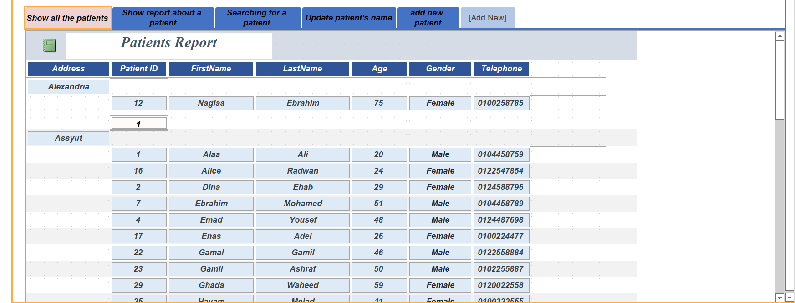
Navigation Form:
Our main interface form consists of :
4 buttons to show the details about doctor, patient, clinics and nurses also we have a button to add new record.
Suppose we click on show patient patients details button we can see all details about Patients .
We can have a speed access to all forms by this form ,we can open select and update forms by clicking on their button , we can show the report and so on.

Slide 26
Reports

Slide 27
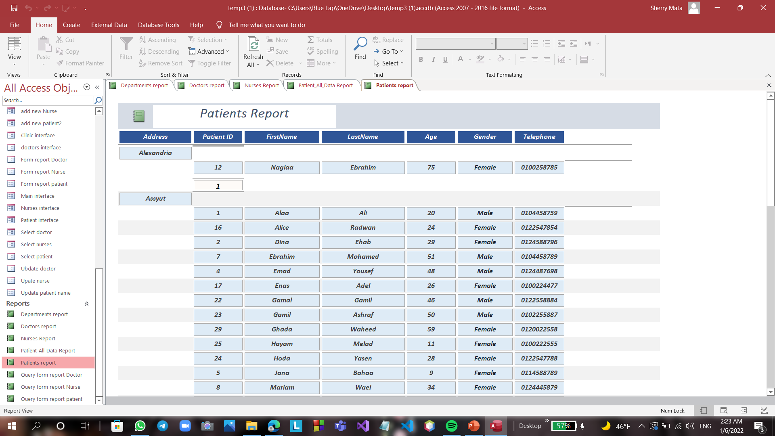
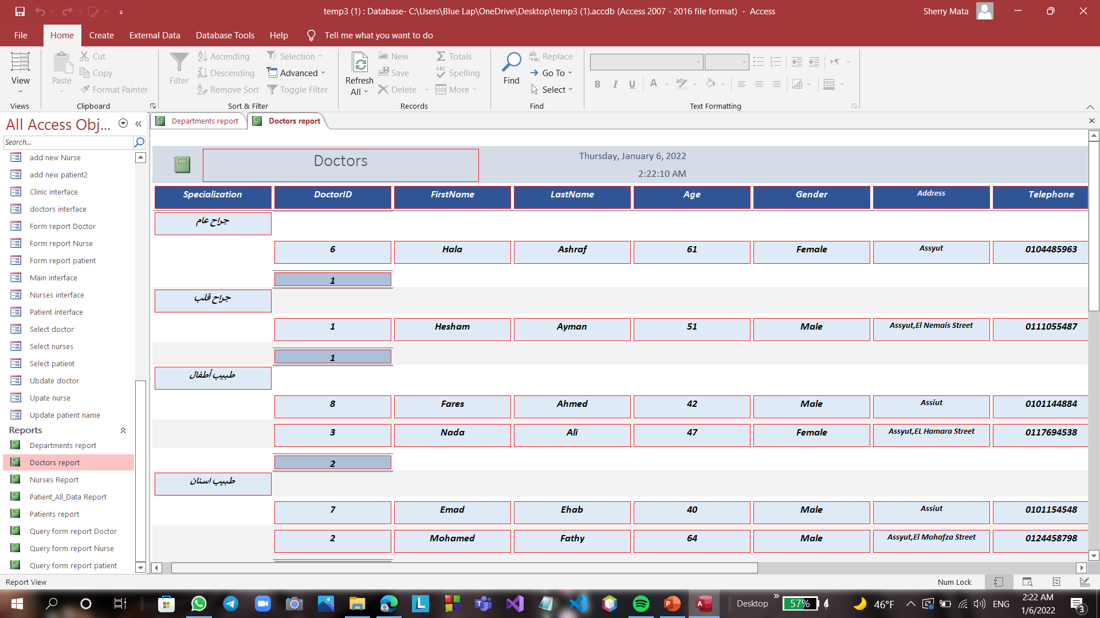
Patient Report:
It is show all data in the patient table.
It is grouped by address (City) and sort by patient’s first name.
Doctor Report:
It is show all data in the doctor table.
It is grouped by specialty of doctor and sort by doctors first name.

Slide 28
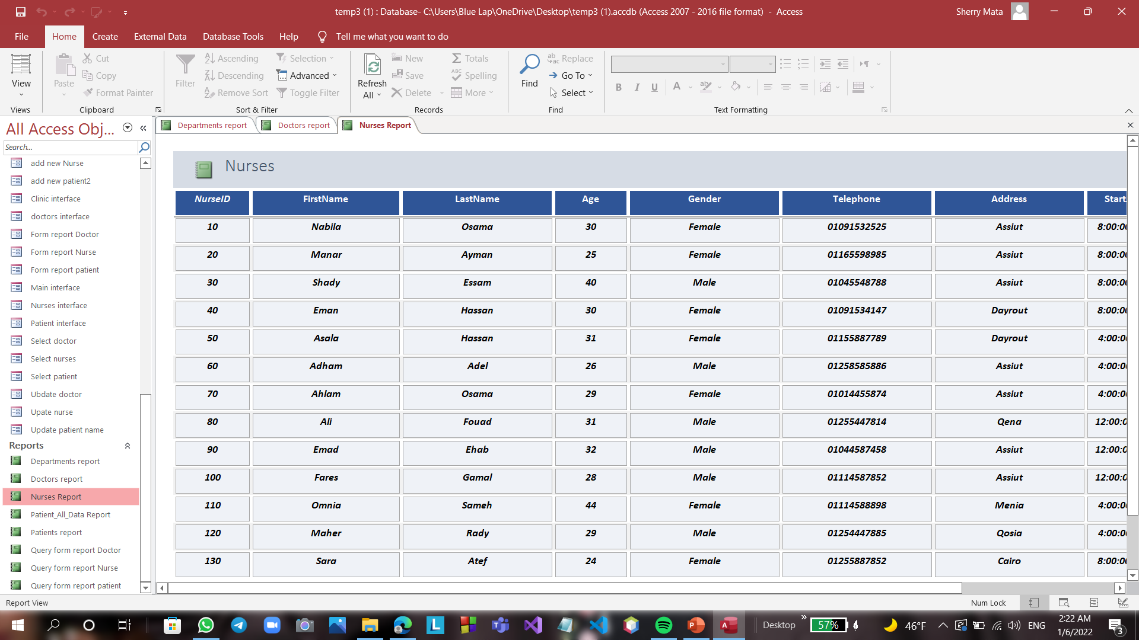
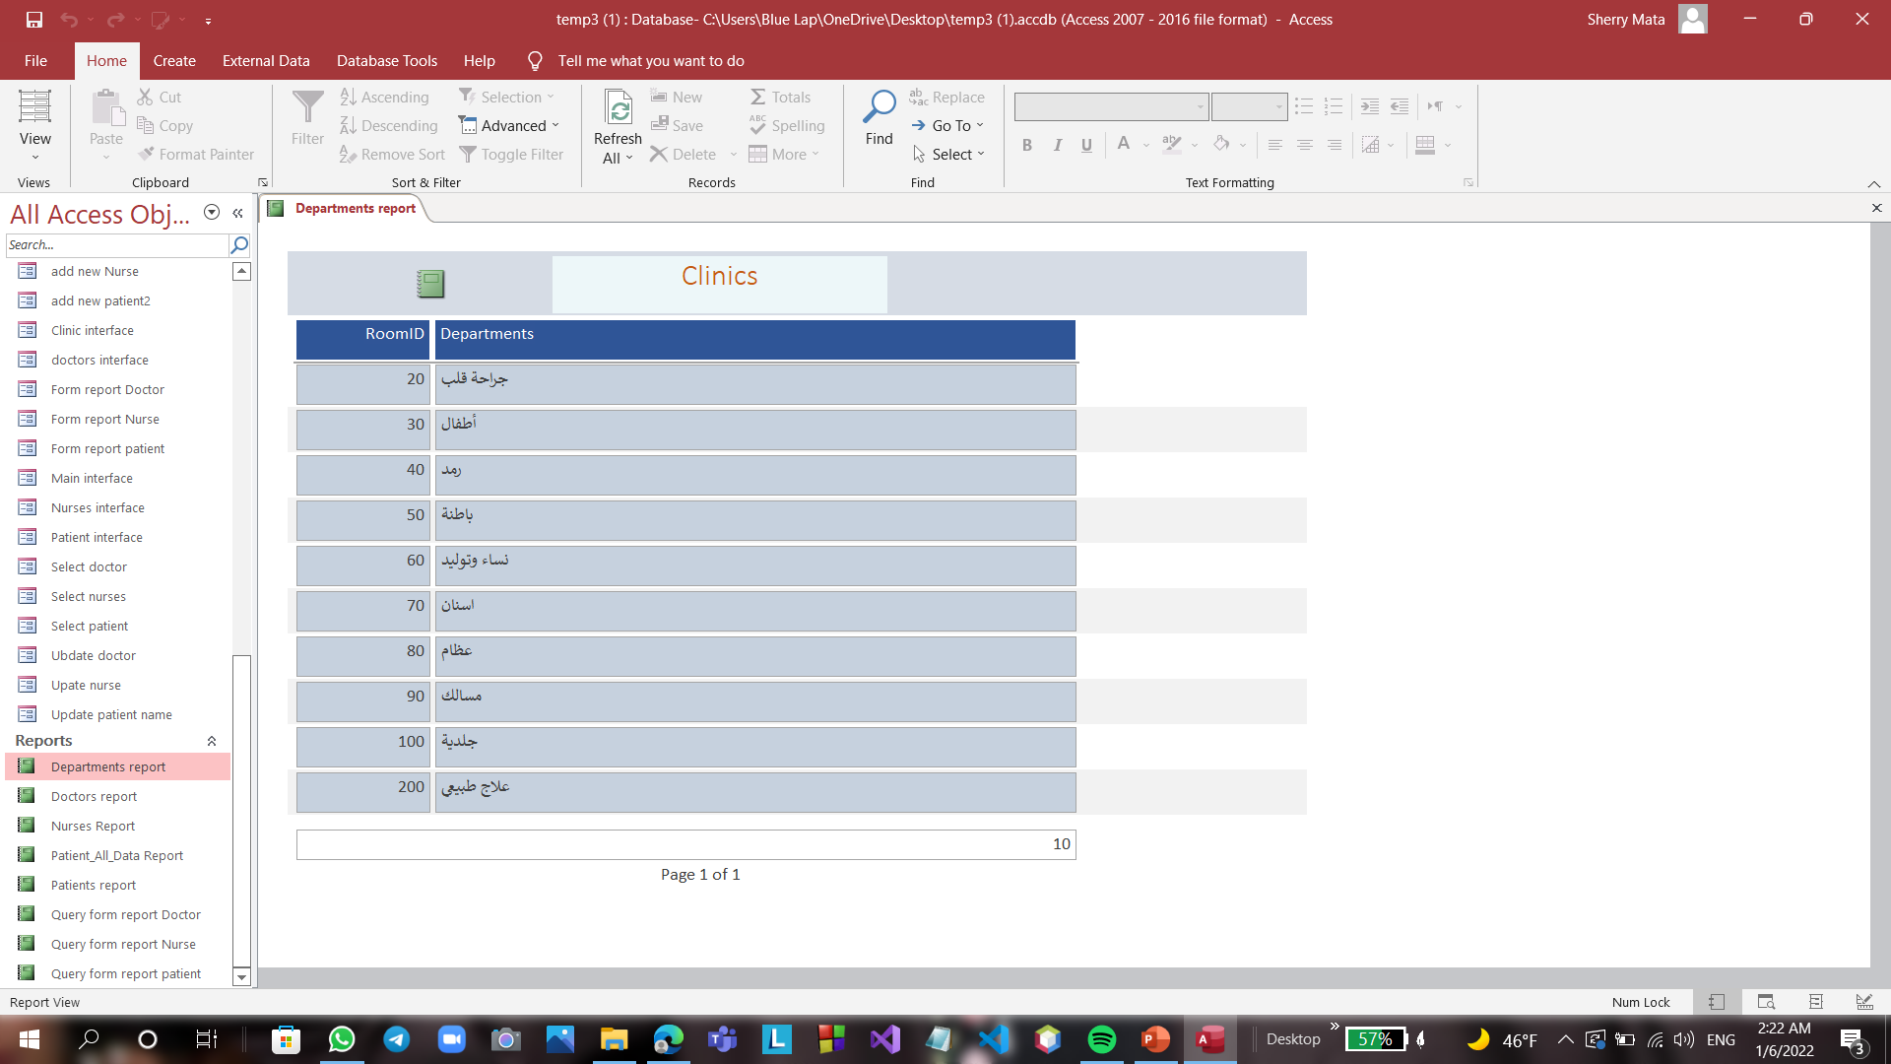
Nurse Report:
It is show all data in the nurse table.
Clinics Report:
It is show all data in the clinics table.

Slide 29
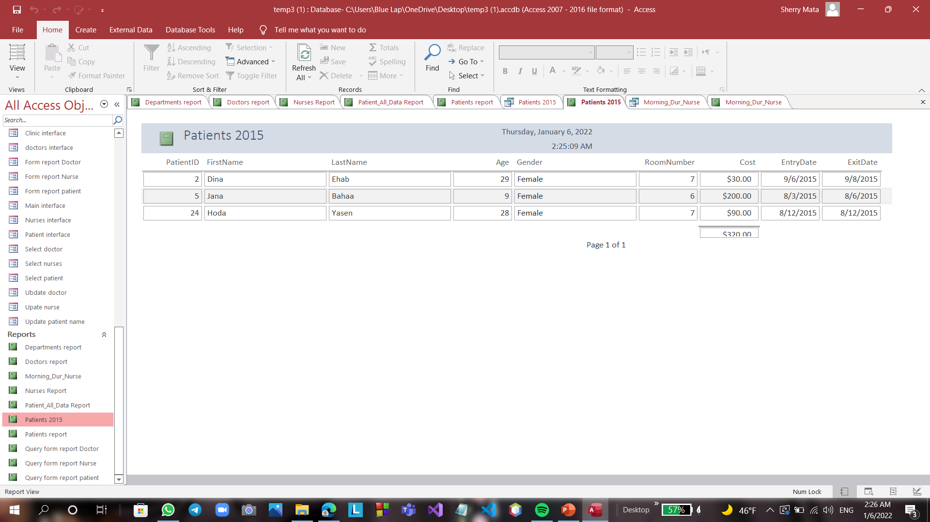
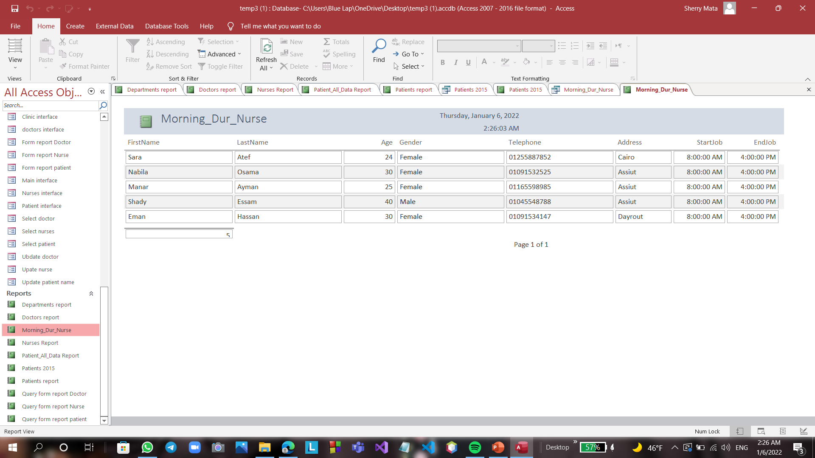
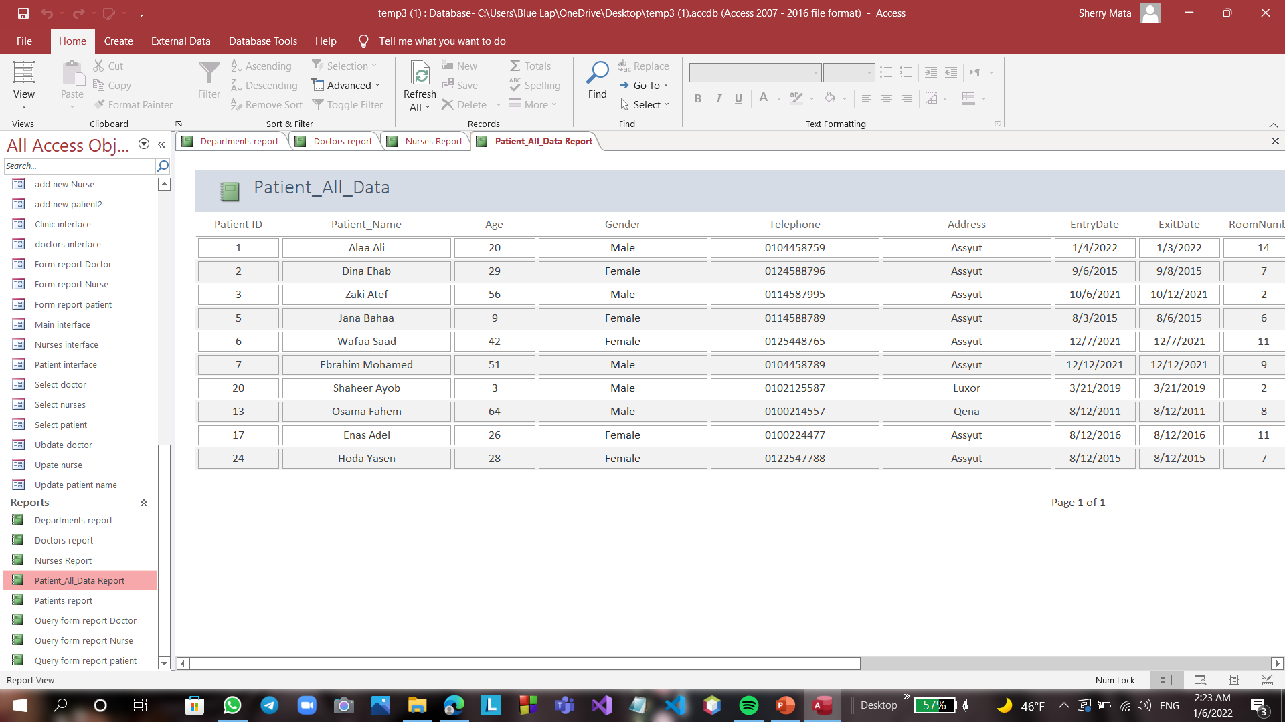
Patient 2015 Report:
It is show all patient’s data in 2015.
This report is linked with patient’s 2015 query.
Morning Duration Nurse Report:
It is show all nurse data that are working on the morning duration.
This report is linked with morning dur nurse query.
Patients All data Report:
It is show all data about the patient and who was his doctor and nurse and when he enter and exit from hospital and how much he paid.
This report is linked with patients all data report dur nurse query.

